Slide 1
Progress Report 8
Sprint 8 - (4/2 - 4/16)
Brian Goughnour, Josh Brown, Steve Stamey, Guylain Kibunzi, Chauncey Davidson

Slide 2
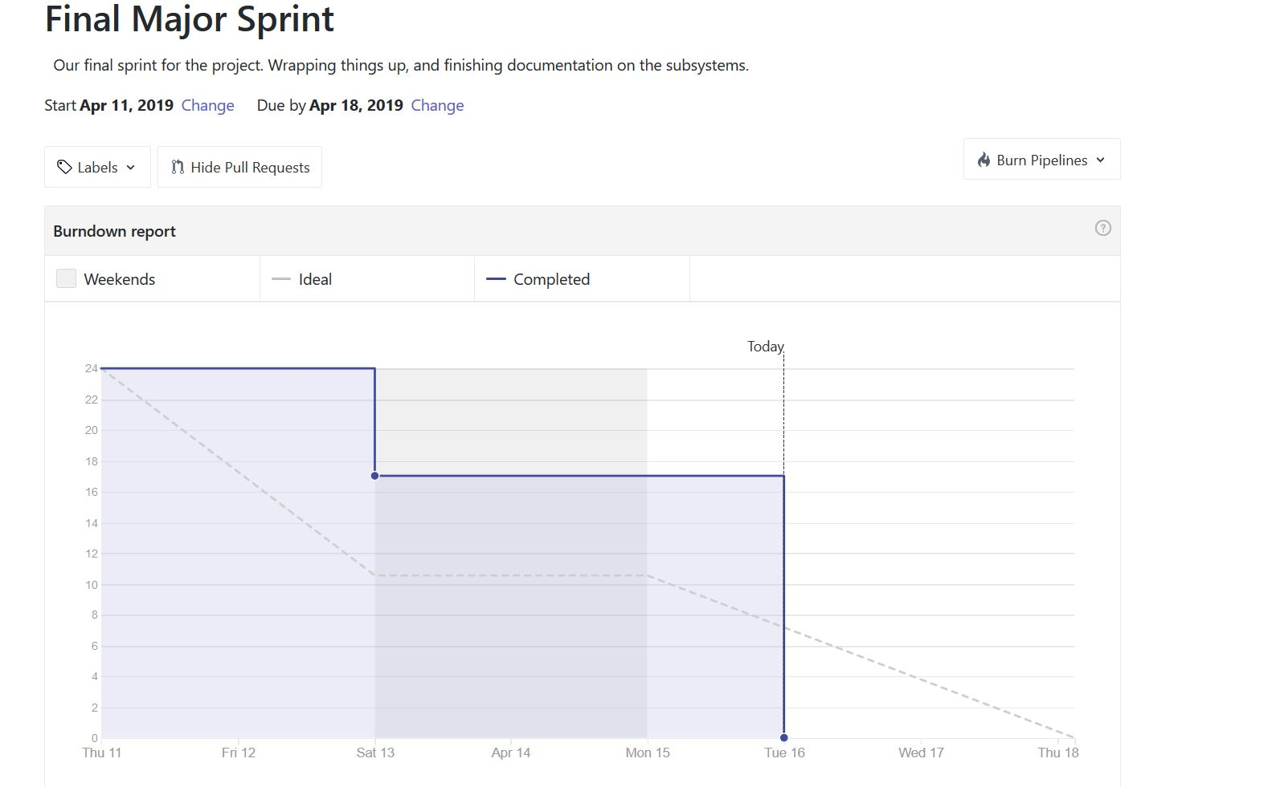
Burndown Report (Last Sprint)

Slide 3
Sprint 8 Responsibilities
Charles Stamey - Settings. Re-implemented due to lost files.
Guylain Kibunzi - Implement Education and start put contents on the pages
Joshua Brown - Updated UI for Calendar and Hot Dial. Calendar time input enabled. Hot Dial now allowed to properly add/remove numbers and store data locally. Documentation.
Brian Goughnour - Testing and documentation.
Chauncey Davidson - Continue Implementing Map events, Find Global Database

Slide 4
Map Updates
Goals
The user can navigate and traverse the map freely
The user can enter in an address and jump to that location
The user can select an address and add it to their list of addresses and locations (into the database)
The user can view their marked locations
Technologies
HTML
Javascript
Leaflet Methods/Imports
Iceboxed
Search Bar plugins, Accurate Geocoding, Map Load Bugs, cleaned up event passing

Slide 5
Goal Tracker
Goals
The user can create a new goal.
The newly created goal will be put into a list and go to the top.
The user can update the list as goals are completed.
A created goal can be removed from the list.
The submodule can accept new goals from other subsystems
Technologies
HTML
Javascript
CSS
Meteor

Slide 6
Education
http://localhost:3000/
http://localhost:3000/
Goals
Provide education and resources to assist and support health care professionals.
Educate community members about health career choices and recruit future professionals.
Technologies
HTML
Javascript
CSS

Slide 7
Final Presentation
Final Testing for Android/iOS
Finish documentation.
Clear up bugs.

Slide 8
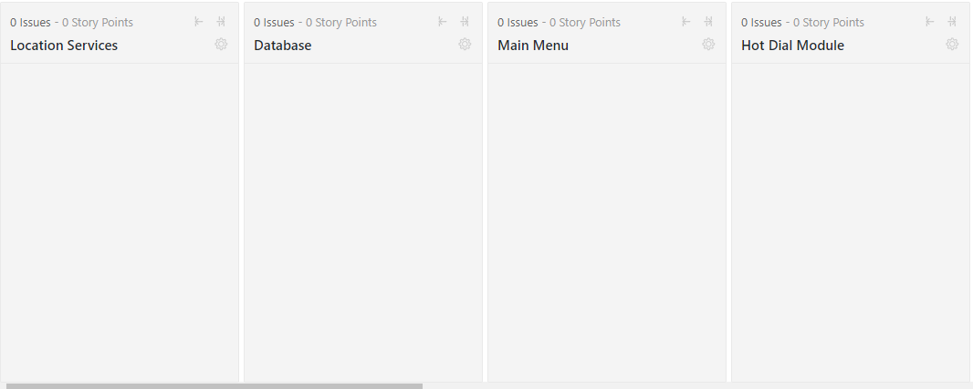
ZENHUB

Slide 9
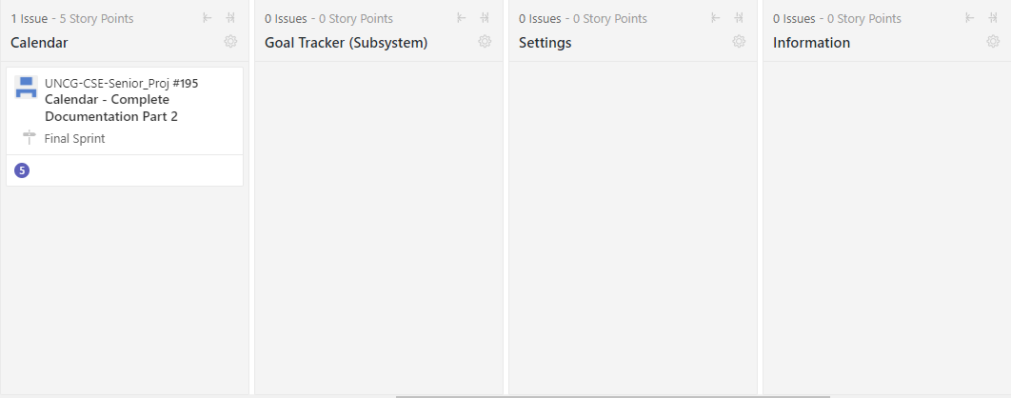
ZENHUB

